Slide 1


Big data and NoSQL
BCSF18M013 (Abdullah Shaukat)
BCSF18M020 (Moaz bin matin)
BCSF18M024 (Ahmad Khursheed)

Slide 2

What is Big data?
Big data is a collection of large scale of structured, semi-structured and unstructured data.
‘Big data’ is a term applied to data sets whose size is beyond the ability of commonly used software tools to capture, manage, and process the data within a tolerable elapsed time.
Big Data refers to very large and complex data sets, so massive in size that they're beyond the capability of managing with traditional software tools. The bulk of Big Data is composed of unstructured data types such as video, photos, audio, webpages, and multimedia content.
The explosion of data volumes, sometimes needing real-time processing are often not lending itself to the structuring rules and processes implemented by RDBMS
To address this problem the solutions such as Hadoop open source solution has been developed which are widely known as ‘NoSQL’.

Slide 3
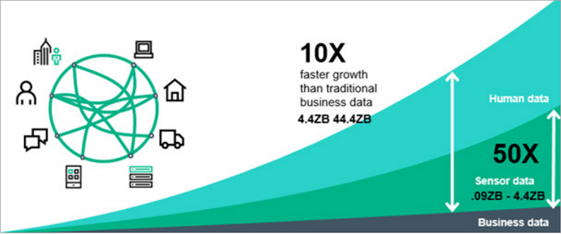
Big data storage:
Big data is large scale of data which is generated due to Social networks, Business organizations, interaction and views of social connected users. It is used for important decision making in business organizations. It is represented by 3Vs (Velocity, Variety and Volume).
There are several characteristics of big data storage- Cloud storage, query interfaces, NoSQL, NewSQL, Scalability, Consistency, Security and Performance etc.
Traditional storage can be efficiently implemented by relational databases like SQL and processed on Weka, Java etc. Scalability is not well managed by relational databases
.These can be efficiently deployed for structured data. Several techniques have been articulated and implemented by researchers to deploy large scale of data.
These novel strategies to store large scale of data provide scalability with less complexity. This is verified with the popularity of storage like Cloudera and NoSQL solutions.

Slide 4

storage techniques:
Big data storage is provided by following three techniques:
Distributed File Systems
NoSQL
NewSQL
Distributed File System: HDFS (Hadoop Distributed File System) is used for distributing large scale of data on different clusters. These clusters work in parallel on chunks of data and after processing merge to form final results.
NoSQL : This storage technique is used for data where tables in rows and columns can not be applied. NoSQL databases provide scalability but with the increase in scale of data, scalability limits are reduced slightly.
NewSQL : Relational databases with novel techniques to process large scale of data comes under this category. This is area where further research is required. NewSQL is used for multi-object transactions like in finance services-50 times faster than simple SQL. VoltDB, Clusterix etc. are examples of this storage technique

Slide 5
Boundaries of Traditional database for Big Data:
RDBMS Solutions have a rigid schema design and data is entered into tables based on that schema. So, what are the limiting factors with these databases for Big Data scenarios? There are many!
A rigid schema means storing data into tables is not flexible. This results in difficulty in scaling the databases for larger sizes.

Slide 6
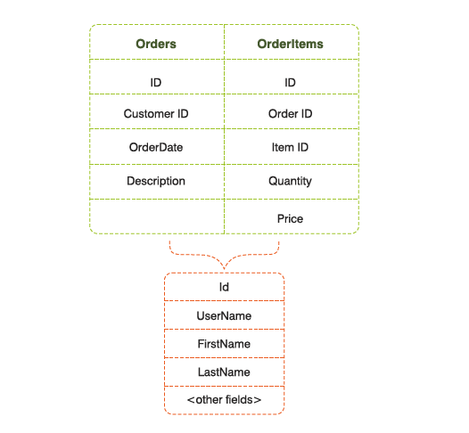
Example:
Assume an order management system for a large scale shopping website, where you need to store orders and items within the orders. In a typical RDBMS database, this will be stored in a table with schema similar to this:
In order to display the names of customer, a JOIN would be required typically with a Customer table. This results in 2 joins-one with Order Item and another with Customers.
once a physical storage limit is reached, traditional RDBMS databases cannot horizontally scale.
One has to shard the data manually by writing specifically into relevant table. For example, in the given scenario, orders for user ids 1-500000 could be written into Feed_A table and 500001 to 1000000 could be written into Feed_B table. This is called manual sharding.

Slide 7
Three V’s of big data:
Volume
The statistic shows that 500+terabytes of new data get ingested into the databases of social media site Facebook, every day. The New York Stock Exchange generates about one terabyte of new trade data per day.
Velocity
The tremendous volume of Big Data means it has to be processed at lightning-fast speed to yield insights in useful time-frames. Accordingly, stock-trading software is designed to log market changes within microseconds. Internet-enabled games serve millions of users simultaneously, each of them generating several actions every second.
Variety
Big Data comes in many forms, such as text, audio, video and 3D, none of which can be addressed by highly formatted traditional relational databases. These older systems were designed for smaller volumes of structured data and to run on just a single server, imposing real limitations on speed and capacity. Modern Big Data databases such as MongoDB are engineered to readily accommodate the need for variety.

Slide 8
What is nosql?
NoSQL is not the name of any particular database.
It refers to a broad class of non-relational databases that differ from classical (RDBMS)
They do not use SQL as their primary query language instead they use API.
NoSQL can be considered "Internet age" databases that are being used by Amazon, Facebook, Google to address performance and scalability requirements
NoSQL databases are used because of their speed, scalability and flexibility, AKA "CLOUD DATABASES“
NoSQL is used for Big data and real-time web apps. For example, companies like Twitter, Facebook and Google collect terabytes of user data every single day. NoSQL database stands for "Not Only SQL" or "Not SQL."

Slide 9
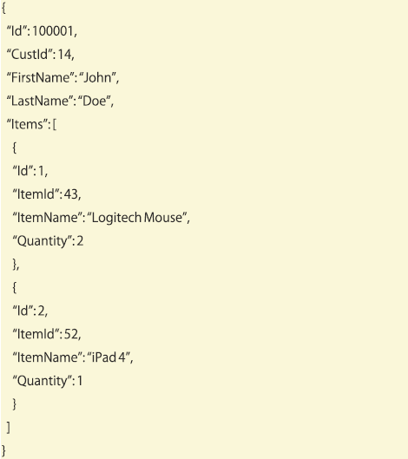
Why NoSQL:
NoSQL database technology is a database type that stores information in JSON documents instead of columns and rows used by relational databases.
NoSQL databases are built to be flexible, scalable, and capable of rapidly responding to the data management demands of modern businesses.
A typical NoSQL document-based storage (e.g., MongoDB) would store data in this manner which is on left side:

Slide 10
Categories of nosql:
Categories:
Column oriented,
Key Value based,
Graph based
Document oriented databases
There are approximately 120 real solutions existing for these categories
Studies have not mentioned the situations in which a particular data storage technique is to be chosen
if users have adequate knowledge of NoSQL categories and their comparison, then it is easy for them to choose best suitable category and then real solutions can be selected from this category

Slide 11
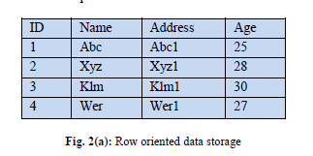
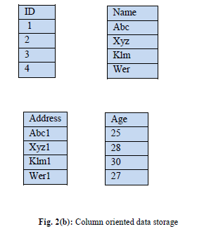
Column Oriented:
In this storage structure, values are not stored in rows. It is stored based on the values of columns
Column data is distributed on different
Column oriented databases provide better indexing and query structure than key value databases
Examples: Google Big Table, Amazon Simple DB

Slide 12
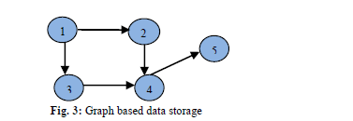
Graph Based:
Relational database works only for predefined schema, dynamic schema can be used by graph based databases
Data can be stored using nodes as users and edges as connection amongst users
Graph databases are not suitable for horizontal scaling i.e. when connected nodes are distributed on clusters, it is very difficult to traverse and manipulate graph.
Examples:Neo4J, Orient DB and Info Grid

Slide 13
Examples of Graph base:
Neo4J
It is the most popular graph-based data storage. Entities are represented by nodes and relationships amongst entities are represented by edges. Traditional relational dataset like schema is not present in this data storage. Indexing of nodes is provided by this storage technique. It is compatible with Java, Python and Ruby. Cypher query language is used for finding nodes and edges representations. Its application is in various fields like storing record in healthcare.
Orient DB
Graph based and document-based storage are combined in this NoSQL database. It uses the scheme-less as well as scheme-mixed format. SQL queries can also be implemented in this data storage technique. Social networking and recommendations are some of key application area of Orient DB.

Slide 14
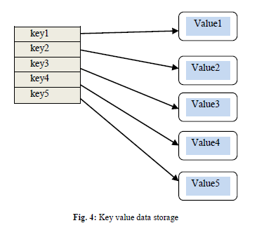
KEY-VALUE:
Data is stored in the form of key which have unique value like Map or dictionary
Key-value pair structure is fast in index i.e. value can be retrieved faster as compared to RDBMS
This storage technique is very efficient for distributed storage.
Key value store is used in Web sessions or any user specific information sites
Examples: Dynamo from Amazon, Azure Table and Redis

Slide 15
Key-value examples
DynamoDB
It is NoSQL database that provides reliable and cost-effective storage. It uses solid state drives (SSD) instead of hard drives. It is implemented by using Amazon’s Dynamo model. Data is stored on multiple data centers (at least three) to provide high reliability. It provides replication with MVCC (multi version concurrency control). Synchronized clusters are also the main characteristics of this storage technique for replicas.
Oracle NoSQL
Big data storage can be well handled by Oracle NoSQL. It combines oracle and Hadoop to store and process unstructured data. JSON format is implemented in this database. It is very simple key-value data storage.

Slide 16
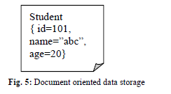
Document Oriented:
Document oriented data storage technique should not be used when there are a lot of relations amongst different tables and normalization is to be incorporated.
This storage technique uses dynamic schema, the advantage is new attribute can be easily added for some documents.
This is different from relational database fixed schema structure where new attribute is to be added for all records.-Document based databases pro-vides indexing based on primary key.
Examples: MongoDB, CouchDB, Orient DB and Mark Logic.

Slide 17
Document base examples:
MongoDB
It is open-source document-oriented data storage. It works on Master Slave storage architecture. Master can read and write in the form of documents while slave can only read. Format for storage is BSON (more compact format i.e. Binary JSON) which uses dynamic schema. Fault tolerance is the main feature of MongoDB. MongoDB allows data to be organized in the form of Collections and not on tables. Querying specified record from this collection is used by dot (.) notations.
CouchDB
It is used for implementing web interface using JSON format. It is written in Erlang and not based on schema as in relational data-base. Http and Rest protocol is used in this data storage. JavaScript query language is used to fetch unstructured data. High scalability and high availability are important features of this storage structure.

Slide 18
Comparison of NoSQL database categories
Parameter | Column Oriented | Graph Based | Key Value | Document Oriented
Storage | Columns | Nodes and edges | Unique Key with value | XML, JSON, BSON
Applications | Sparse data | Social connections | Indexing | Programming objects storage
Examples | Big Table, Cassandra | Neo4J, Info Grid | Dynamo, Oracle NoSQL | MongoDB, CouchDB
Format | Flexible schema | Dynamic schema | Schema-less | Schema-less
Advantages | Scalability | High fault tolerance | Less query response time | Generalized storage for objects
Flexibility | Average | High | High | High
Performance | Good | Varying | Good | Good
Scalability | High | Varying | High | Varying
Flexibility | Average | Good | Good | Good
Complexity | Low | High | Low | Low

Slide 19

NoSQL query language:
The analysis of query model is very important for any data storage. There is no standard query language articulated for NoSQL databases .
Many NoSQL database use its own query language that is not applicable for other types of database. CQL (Cassandra Query Language) for Cassandra, Cypher for Neo4J, JavaScript for CouchDB are some of examples.
It is active research area to define and develop NoSQL databases standard query language.
The difficulty in developing standard query language for NoSQL is that every solution is designed for specific purpose and use different formats and schema.

Slide 20
Conclusion
In this paper, techniques for Big data storage are highlighted. Several techniques and solutions are available for efficient storage of structured, semi-structured and unstructured data.
Distributed data storage, NewSQL and NoSQL are most commonly used technique identified in this paper. Applications of these techniques are elaborated with advantages and disadvantages. NoSQL data storage technique is the most popular amongst these solutions.
Categories of NoSQL data storage- Column oriented, Graph based, Key value based, and document based are explained in detail with real examples. In this paper, these categories are compared based on several parameters.
Requirement specific solutions are provided for guidance of reader to select most suitable technique. It is explained that query language is not standardized for NoSQL databases due to different protocols and schema used by four categories. Query languages are briefed for some solutions.
In future, these standard query languages can be further researched and developed by readers. Moreover, extra parameters can be added to compare the NoSQL databases based on architecture.

